Slide 1



Graduation Project: Salesforce Community Management Lightning Application
Aslene Ouaze ING-A3-GL-AL-04

Slide 2
TABLE OF CONTENTS
01
02
03
04
Introduction
Context
Problem & Objectives
Study of the existing
Methodology & Architecture
05
Conception
06
Implementation
Conclusion & Perspectives

Slide 3
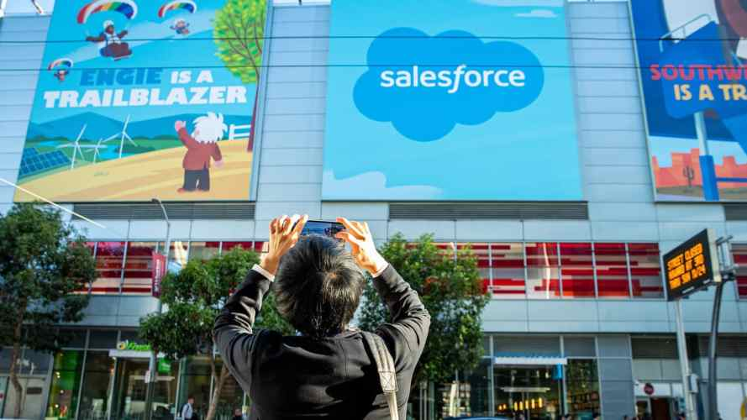
Introduction
In today’s digital world, where businesses are increasingly relying on cloud-based services and software.
This area demonstrates multiple important investments thanks to the increasing number of interested developers in who offer an infinity of useful software also known as CRMs.
These applications are accessible everywhere and through multiple devices.
One of the most popular ones is Salesforce.
3

Slide 4

Context
01

Slide 5

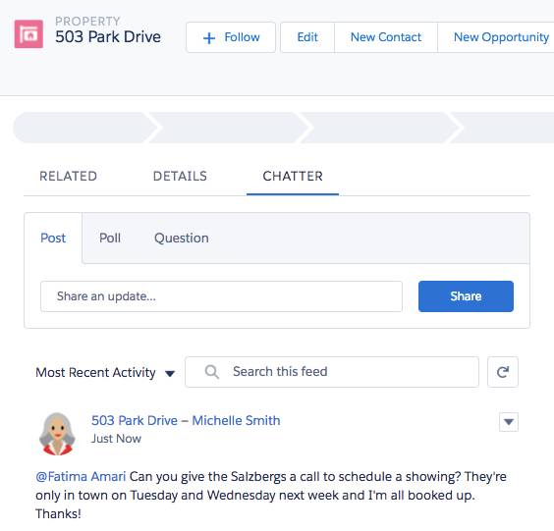
Context
Salesforce is a highly customizable advanced CRM,
It stores customer data
Provides ways to collaborate with other workers
Provides High Impact & Low Effort:
The platform goal is to make big changes with minimal effort
The platform goal is to solve mistakes that impact the buyer => Dynamic expandable interfaces using additional extensions. (e.g. Chatter extension)
5

Slide 6
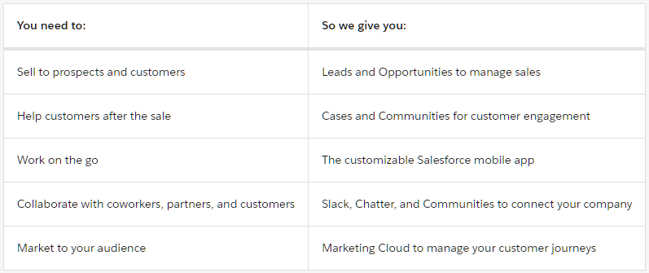
Context
Here are some common things businesses want to do with Salesforce and the features Salesforce gives that support those activities
6
Notes:
This usecase table is given as an example from the creators of salesforce to help define salesforce better

Slide 7
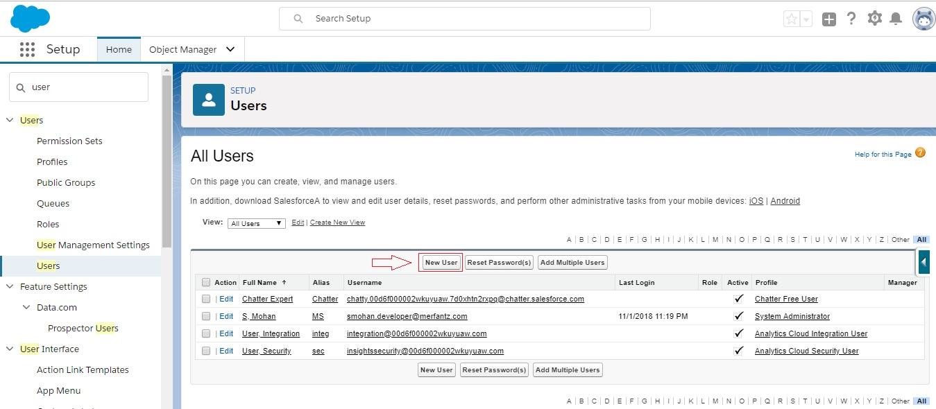
Context
In Salesforce, each user is identified by a unique username and profile.
Along with other settings, the profile determines what tasks a user can perform, what data they can view, and how they can use the data.
7

Slide 8
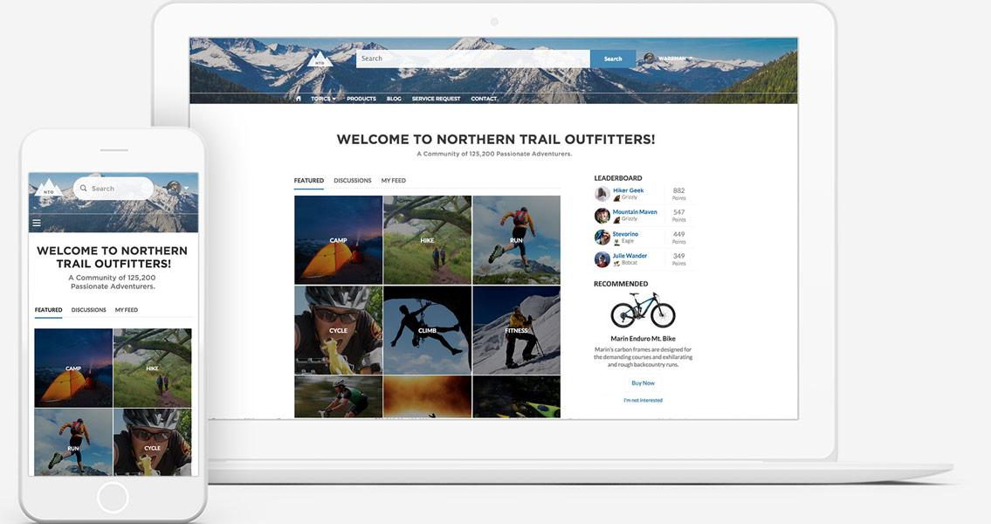
Context
As a Salesforce admin, you manage users in your organization.
In addition to creating and assigning users, user management includes managing permissions and licenses, delegating users, and more
8

Slide 9
Problem & Objectives
02

Slide 10

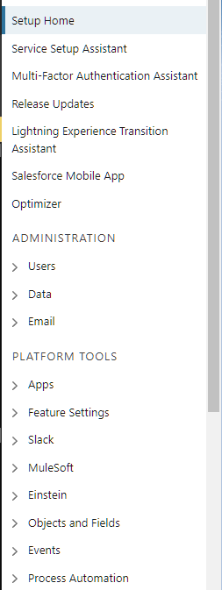
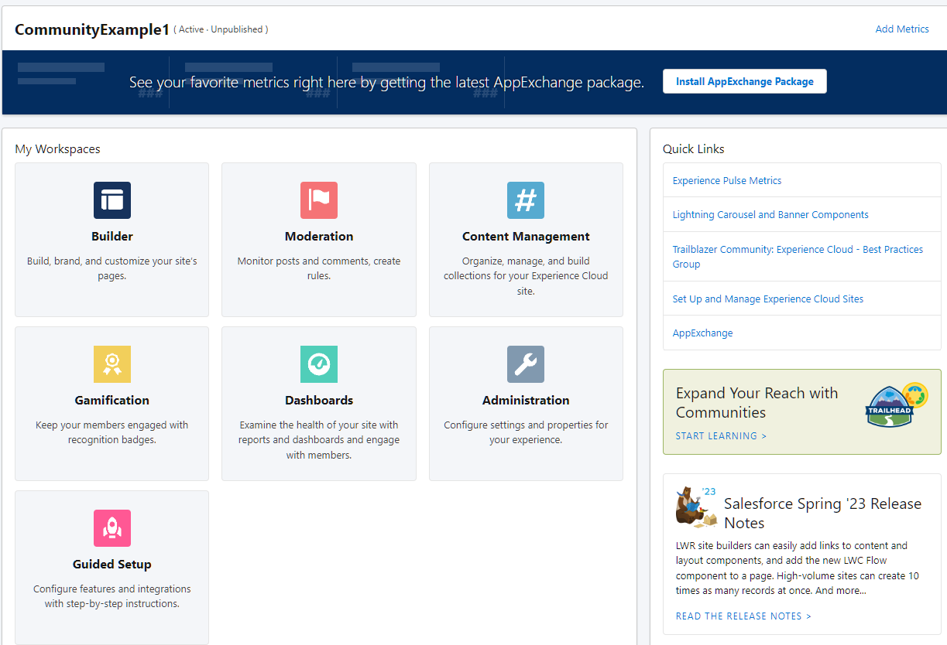
Problem
Users are managed in the community through a Salesforce interface and over several stages, making it difficult and time-consuming.
Different interfaces for managing community users
10
Notes:
This means there are so many places to go when trying to manage even the simplest tasks regarding users and their community so for example if the admin wants to manage all his users he will have to access the setup home but when accesing his community users he will have to access a diffrent interface that takes so much time to load

Slide 11
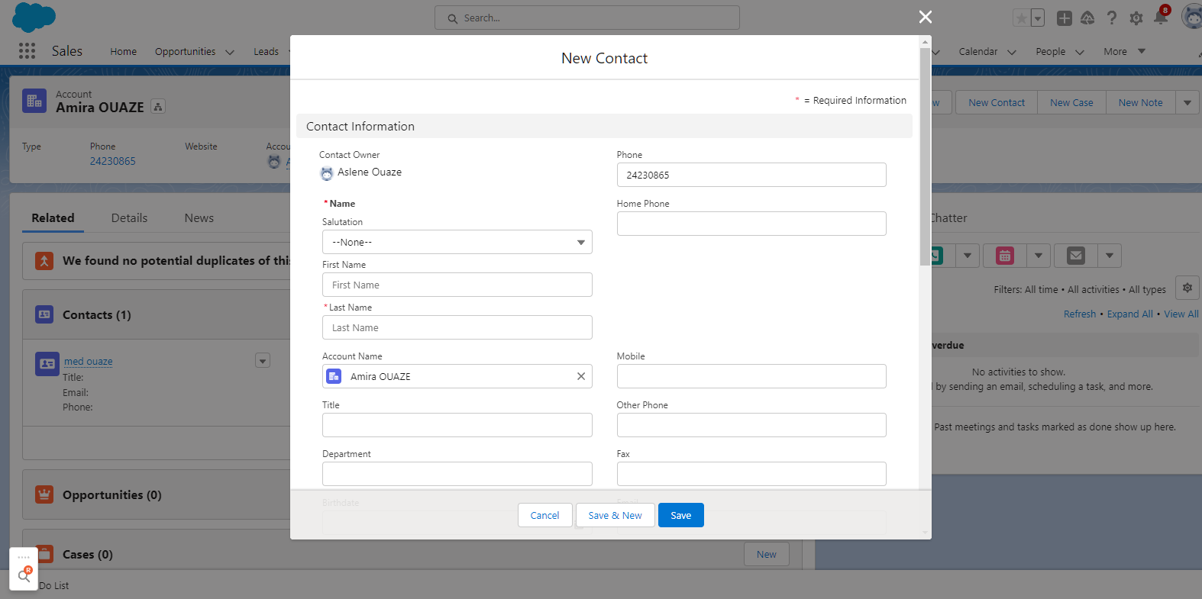
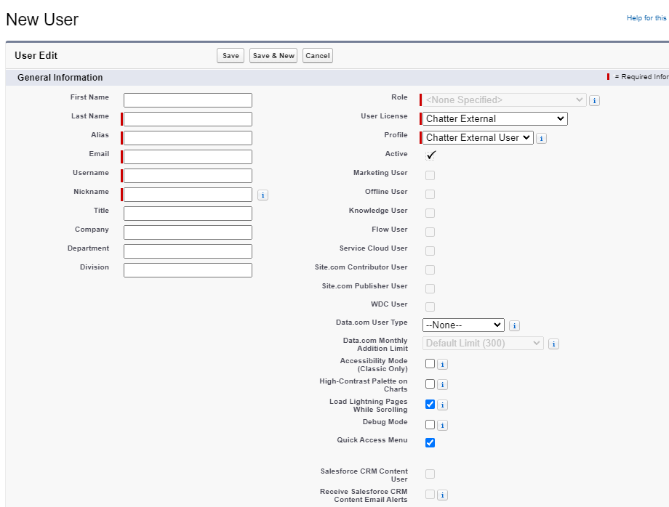
Problem
For example, adding a new member to a community requires navigating between the account’s contact interface and the user management interface
Tracking members’ connection history cannot be done
Also adding multiple members at once cannot be done efficiently
11
Notes:
This means there are so many places to go when trying to manage even the simplest tasks regarding users and their community so for example if the admin wants to manage all his users he will have to access the setup home but when accesing his community users he will have to access a diffrent interface that takes so much time to load

Slide 12
Objectives
It is in this context that our work is integrated, the main objective of which is to design and develop a powerful tool to facilitate the task of managing the users of the community.
This application is intended to offer any organization a simple and effective means to manage the "administration" part, then the connection history part so that the administrator can change the licenses of users based on their respective connection history.
Provide a synthetic dashboard visualizing the KPIs (Key Performance Indicators)
As well as a smart solution that helps system administrators and community managers to overcome the difficulty of managing large communities and organizations.
12

Slide 13
Study of the existing
03

Slide 14

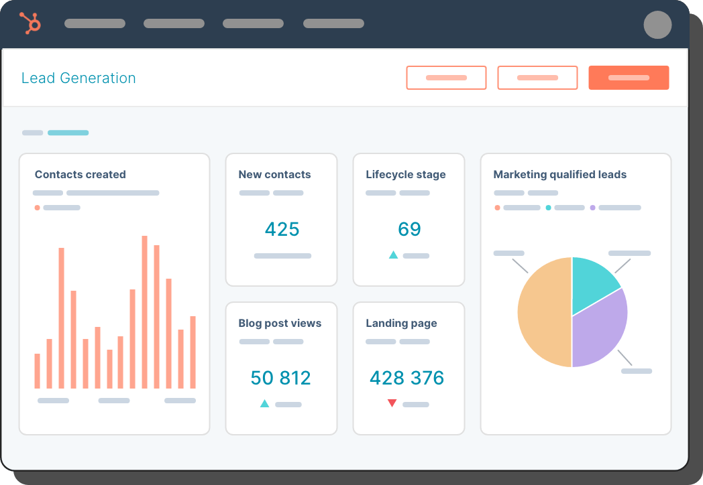
HubSpot
HubSpot is a popular marketing, sales, and customer service platform that integrates with Salesforce.
HubSpot uses Salesforce's user management features to allow organizations to manage their teams and control access to different parts of the application.
14

Slide 15
HubSpot
(+) Pros:
User-Friendly Interface
Role-Based Access ( custom roles and specific permissions to users )
User Activity Tracking
(-) Cons:
Complexity
Cost (Pricing structure is based on the number of contacts)
Learning Curve (Managing users and configuring access control)
15
Notes:
User-Friendly Interface: HubSpot's user interface is designed to be user-friendly, making it easy to manage user accounts, roles, and permissions. This helps businesses save time and increase efficiency when managing users.
Role-Based Access: HubSpot's role-based access control allows businesses to create custom roles and assign specific permissions to users based on their roles. This ensures that users only have access to the tools and data they need to do their jobs effectively.
User Activity Tracking: HubSpot tracks user activity, allowing businesses to monitor user behavior and ensure compliance with company policies and regulations.
Complexity: While HubSpot's user management interface is user-friendly, it can be complex, particularly for businesses with a large number of users. This may require more time and effort to manage and configure.
Cost: HubSpot's pricing structure is based on the number of contacts in a business's database, which can make it more expensive for businesses with larger teams. This may be a concern for businesses with many users who require access to HubSpot's tools and features.
Learning Curve: For businesses new to HubSpot, there may be a learning curve when it comes to managing users and configuring access control. This may require additional training or resources.

Slide 16
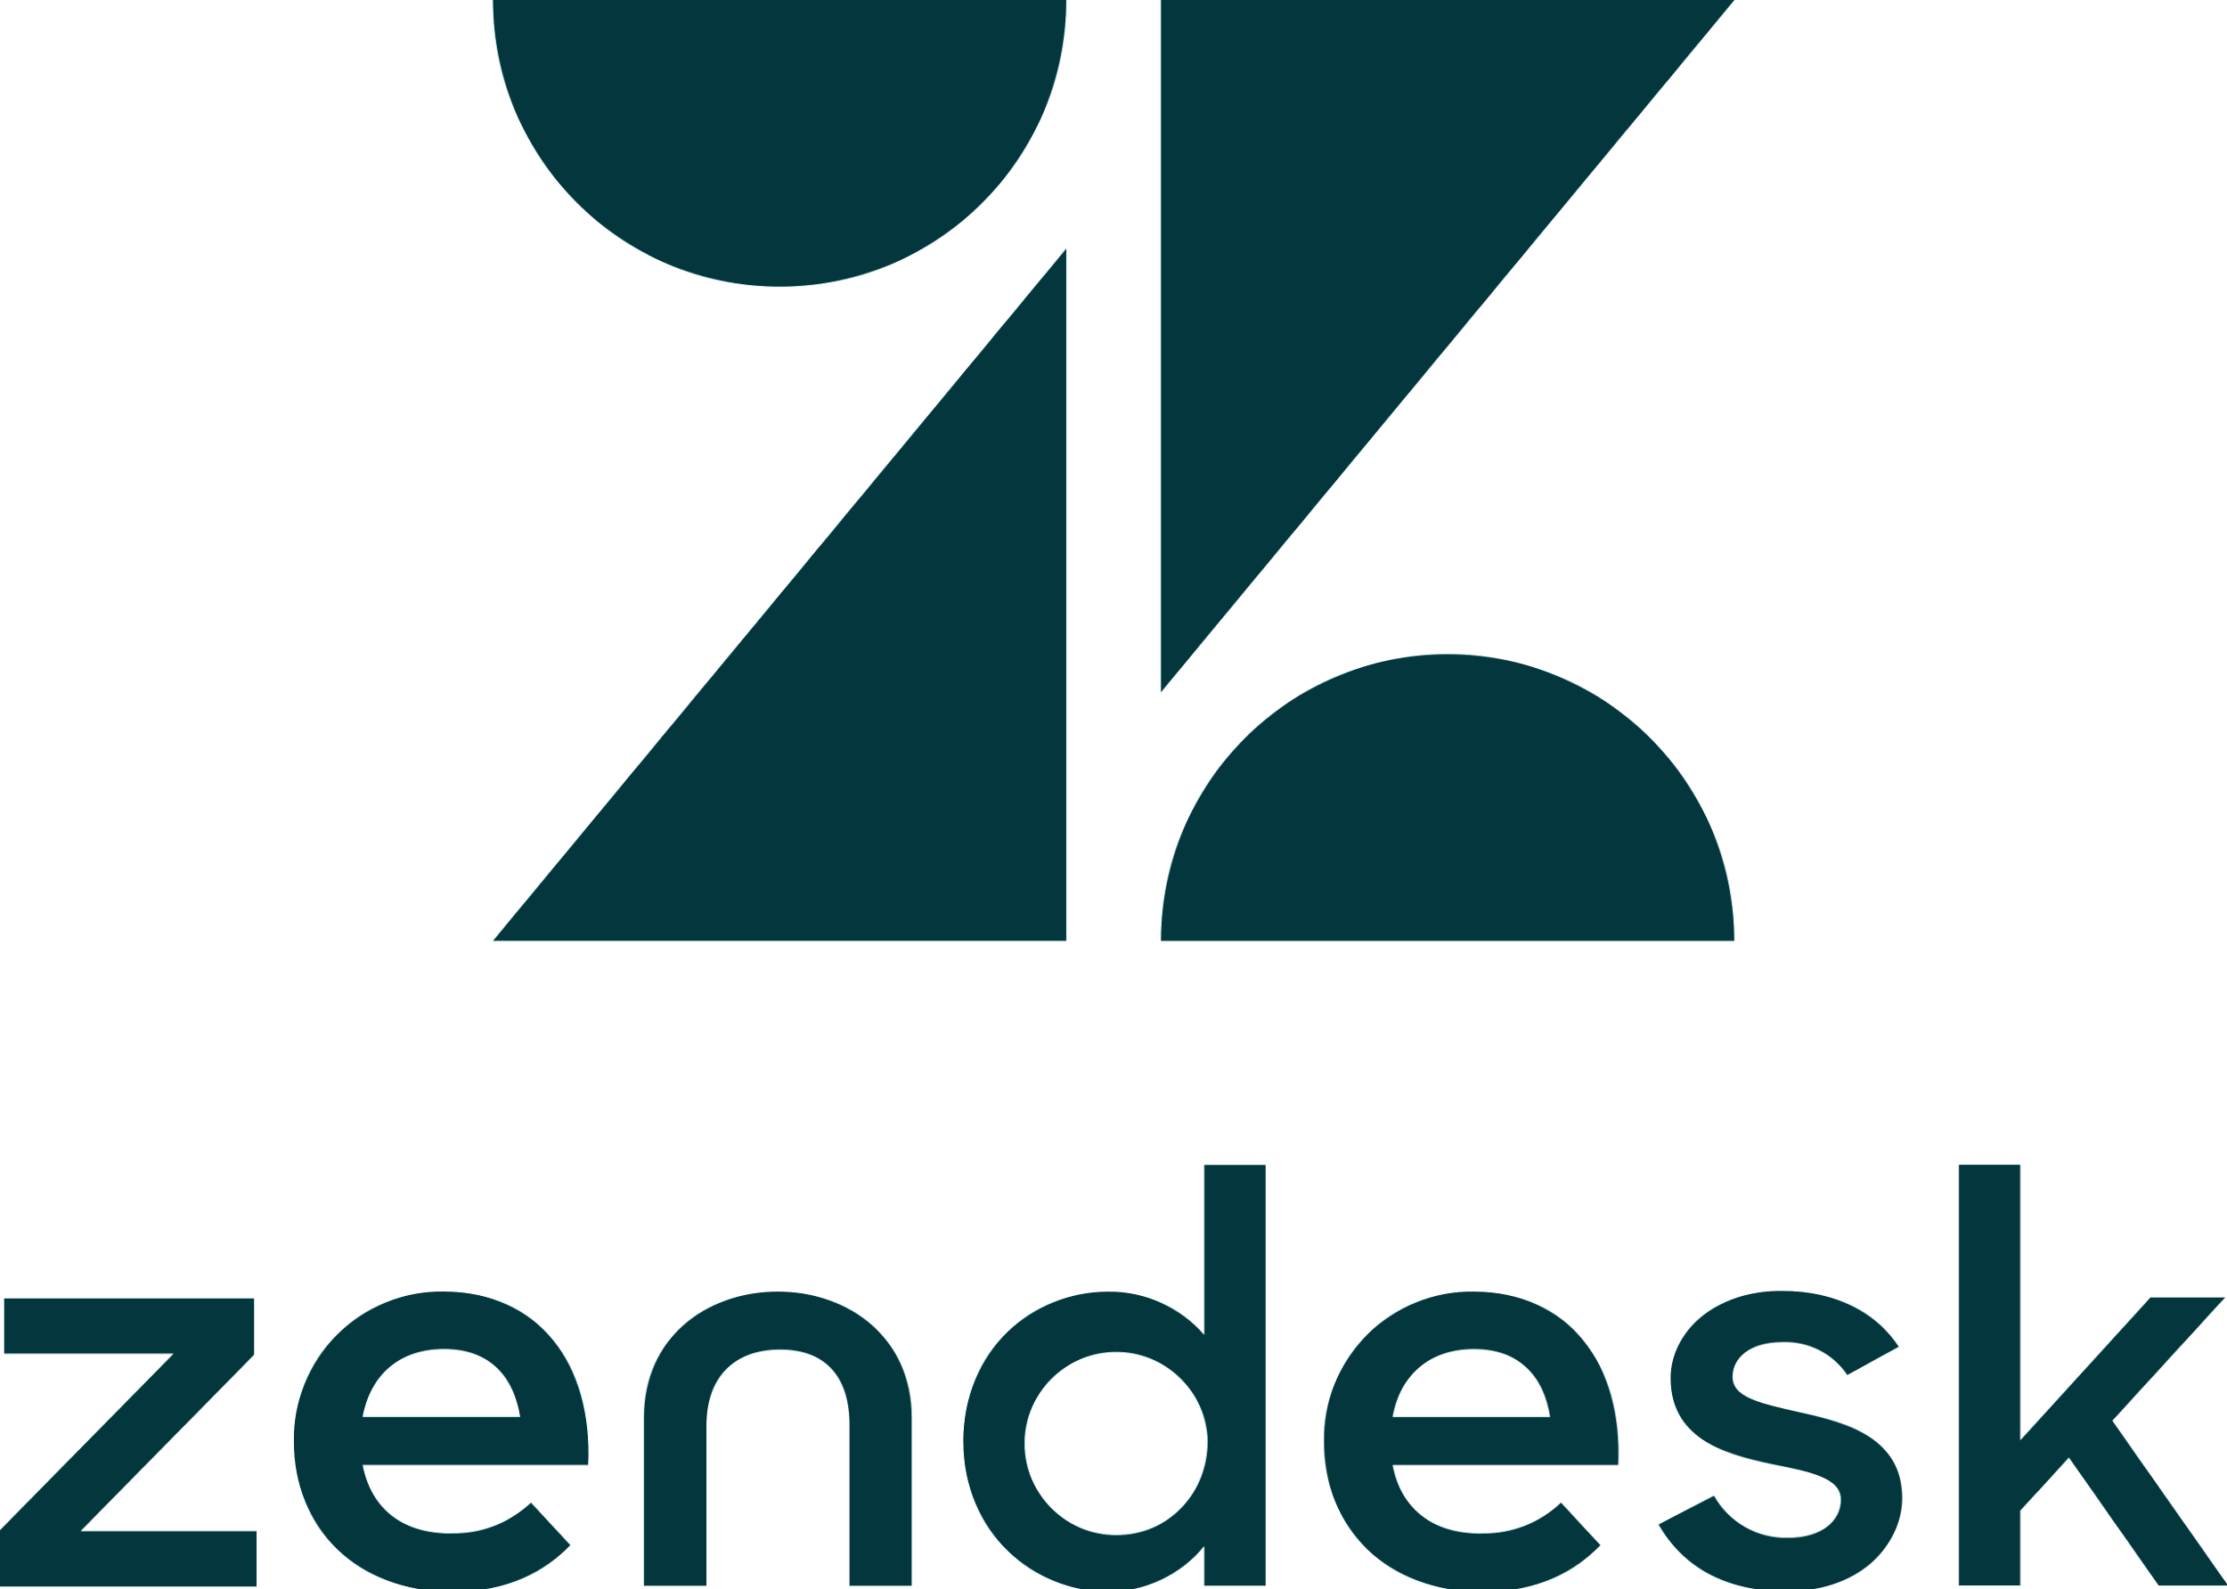
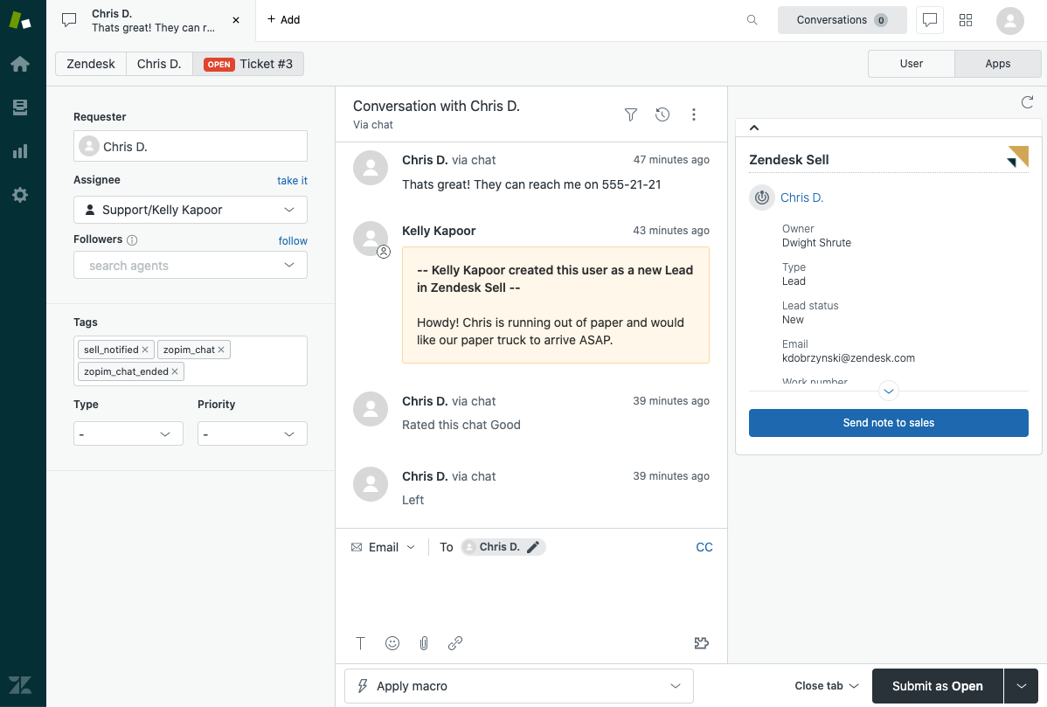
ZenDesk
ZenDesk is a customer support platform that integrates with Salesforce.
ZenDesk uses Salesforce's user management features to allow organizations to manage their support teams and control access to different parts of the application.
16

Slide 17
ZenDesk
(+) Pros:
User Analytics
Customizable Notifications
User Collaboration ( shared views and comments )
(-) Cons:
Limited Permissions
Limited Customization
Cost (Pricing structure is based on the number of agents)
17
Notes:
User Analytics: Zendesk provides user analytics, allowing businesses to monitor user behavior and identify areas for improvement in the support process.
Customizable Notifications: Zendesk allows businesses to set up custom notifications for user actions, such as ticket creation or update. This helps ensure that teams stay informed and can take action quickly.
User Collaboration: Zendesk provides tools for user collaboration, such as shared views and comments, allowing teams to work together more efficiently.
Limited Permissions: Zendesk's role-based access control may not offer as much granularity as some businesses require. For example, it may not be possible to create custom permissions for individual users or specific tasks.
Limited Customization: While Zendesk's user interface is user-friendly, it may not offer as much customization as some businesses require. This may be a concern for businesses with specific branding or customization requirements.
Cost: Zendesk's pricing structure is based on the number of agents, or users who interact with customers, which can make it more expensive for businesses with larger teams. This may be a concern for businesses with many users who require access to Zendesk's tools and features.

Slide 18
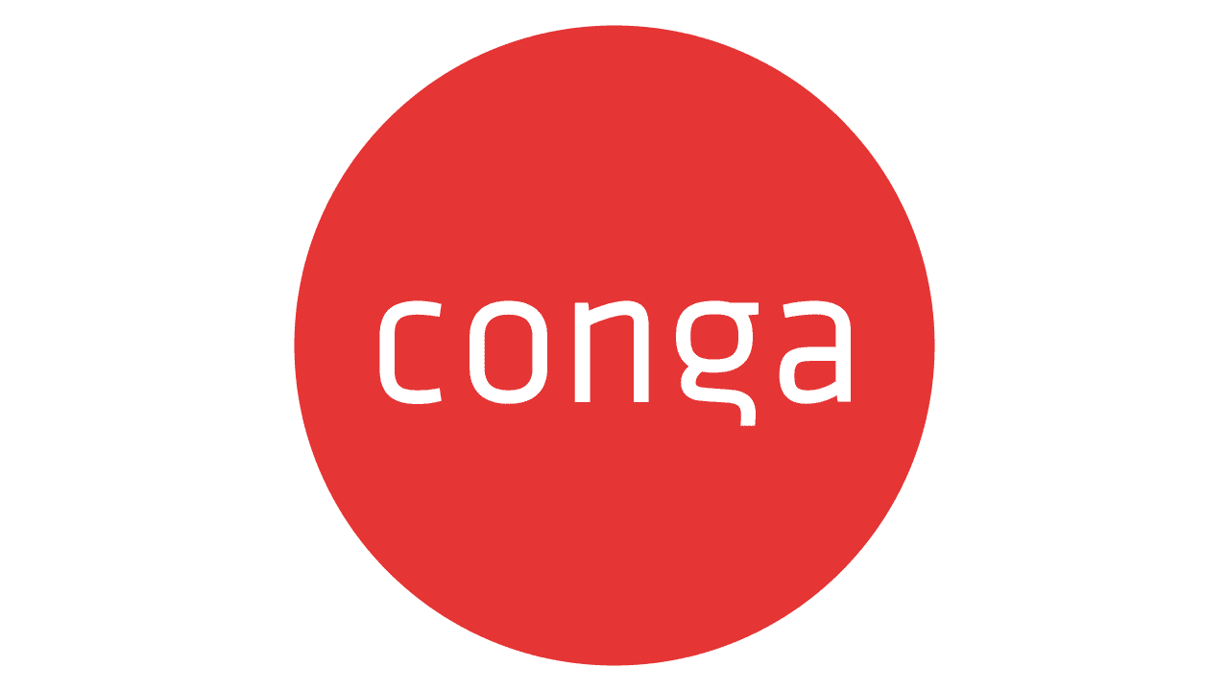
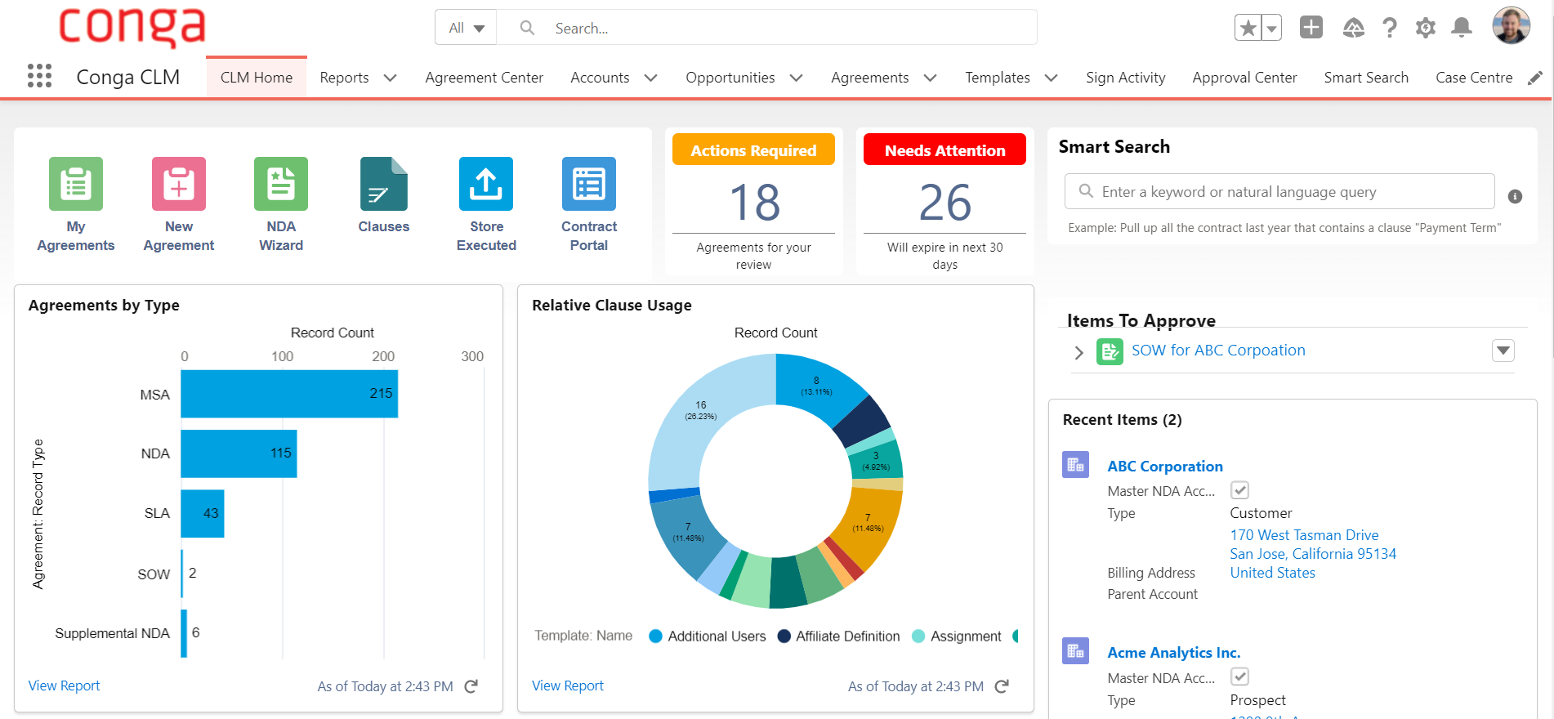
Conga
Conga is a document generation and reporting platform that integrates with Salesforce.
Conga uses Salesforce's user management features to allow organizations to manage their teams and control access to different parts of the application.
18

Slide 19
Conga
(+) Pros:
Customizable Workflows
Centralized User Management
Collaboration Tools (document sharing and commenting)
(-) Cons:
Limited third-party Integrations
Cost (expensive for businesses with larger teams)
Complexity of the U/I
19
Notes:
Customizable Workflows: Conga offers customizable workflows, allowing businesses to automate document creation and approval processes and ensure that documents are routed to the right people at the right time.
Centralized User Management: Conga provides a centralized user management system, allowing businesses to manage all their users from one central location. This saves time and ensures consistency across the organization.
Collaboration Tools: Conga provides tools for user collaboration, such as document sharing and commenting, allowing teams to work together more efficiently.
Limited Integrations: While Conga integrates with several third-party applications, some businesses may require integrations with more specialized tools or systems, which may not be available.
Cost: Conga's pricing structure can be more expensive for businesses with larger teams. This may be a concern for businesses with many users who require access to Conga's tools and features.
Complexity: Conga's user management interface can be complex, particularly for businesses with a large number of users. This may require more time and effort to manage and configure.

Slide 20
Methodology & Architecture
04

Slide 21
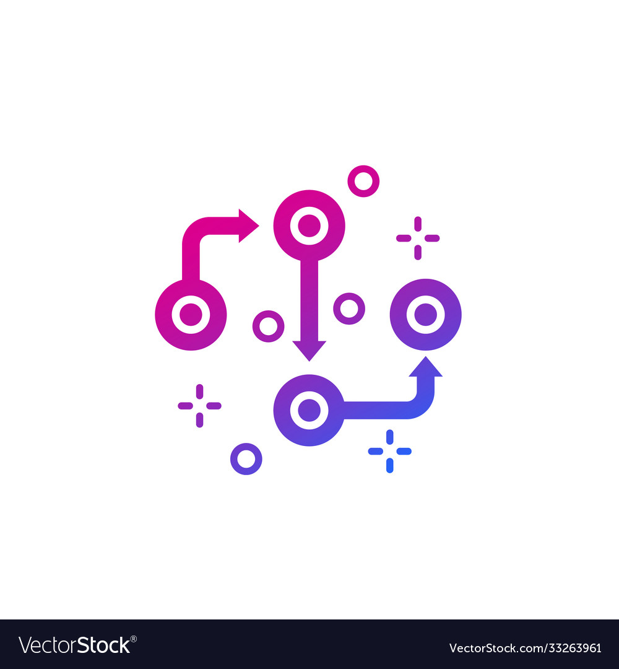
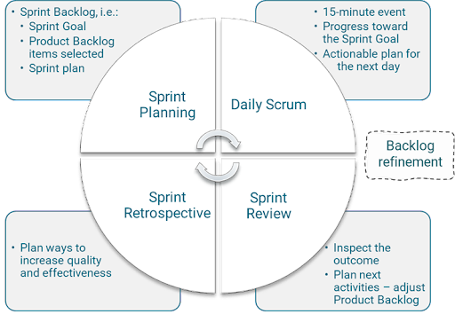
Methodology
Our chosen methodology of work for this project will be the standard SCRUM methodology.
SCRUM is a framework for project management commonly used in software development.
It is designed for teams of ten or fewer members who break their work into goals that can be completed within time-boxed iterations.
21

Slide 22
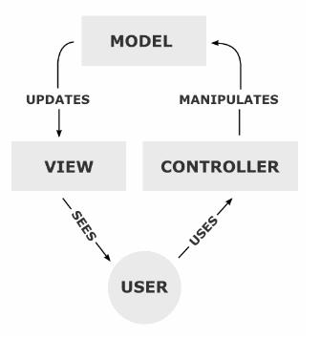
Architecture
Our chosen architecture of work for this project will be the MVC architecture since it is recommended by the Salesforce developer’s community
The Model View Controller (MVC) is a software architecture model that separates the representation of information from the user's interaction with it.
22

Slide 23
Conception
05

Slide 24

Functional Needs
Choice of the community:
Select the community to which we will manage the users, as well as provide a search feature for the community list
Manage users:
The system must allow users to be managed with the functionalities of activation,
deactivation, modification, and consultation of the list of users via a data table.
Creation of different filters that allow us to facilitate the navigation of the list of users.
Manage connection history:
Create a chart that shows the number of user connections per day, week, year, or
according to a well-determined date. This allows the administrator to modify the user’s license
Monitor failed login attempts
Offer a synthetic dashboard
Offer a smart Salesforce assistant
24

Slide 25
Non-Functional Needs
Security:
Access to information is only possible after verification of privileges and access rights,
for example Authentication, Redirections.
Ergonomics and user-friendliness:
The application will provide a user-friendly and easy-to-use interface that does not
require any prerequisites, so it can be used by all types of users (even non-computer specialists).
Extensibility and maintainability:
The architecture of the application will allow the evolution and maintenance (addition
or deletion or update) at the level of its various modules in a flexible manner.
Performance:
The application must be efficient, i.e. the system must react within a period that does
not exceed 5 seconds, whatever the action of the application.
Availability:
The application will be available on 24/24, and 7/7 except during the maintenance period.
25

Slide 26
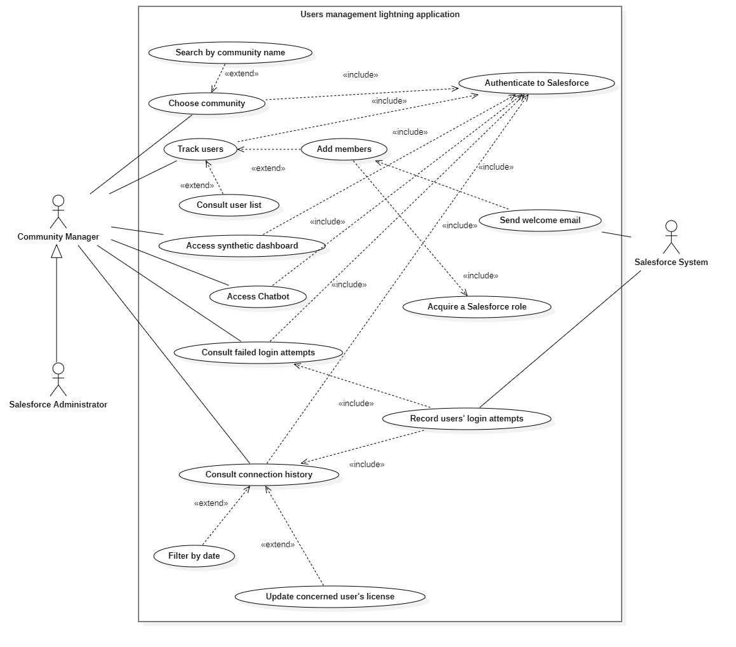
Global Use Case Diagram
26

Slide 27
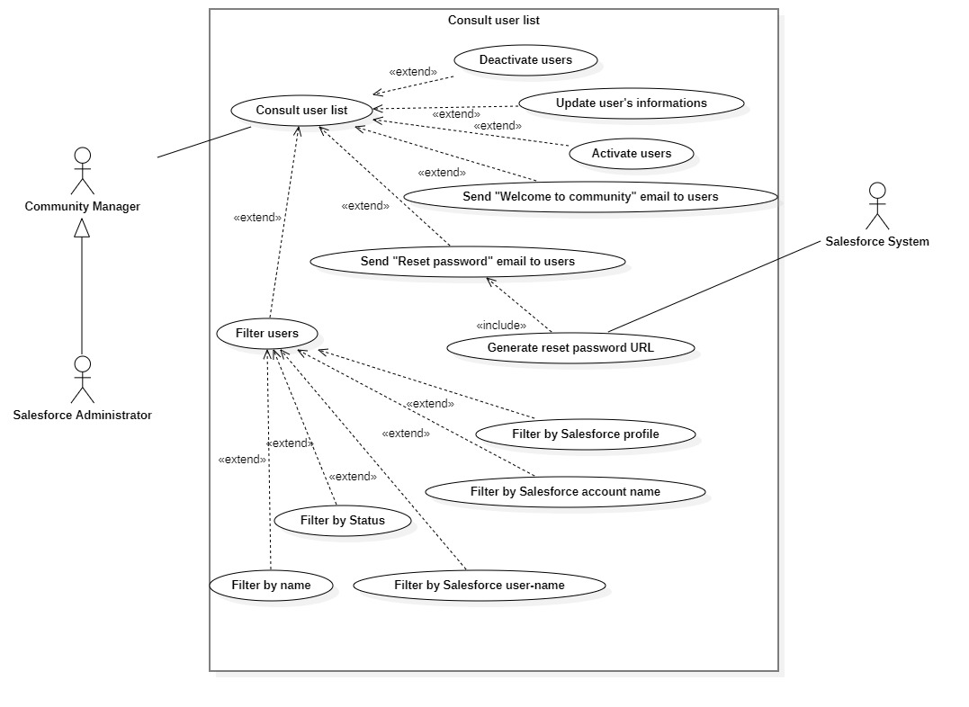
Consult users list UC
27

Slide 28
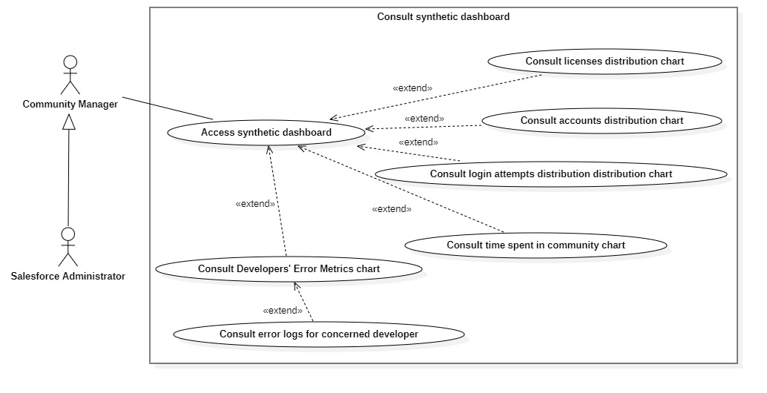
Consult synthetic dashboard UC
28

Slide 29
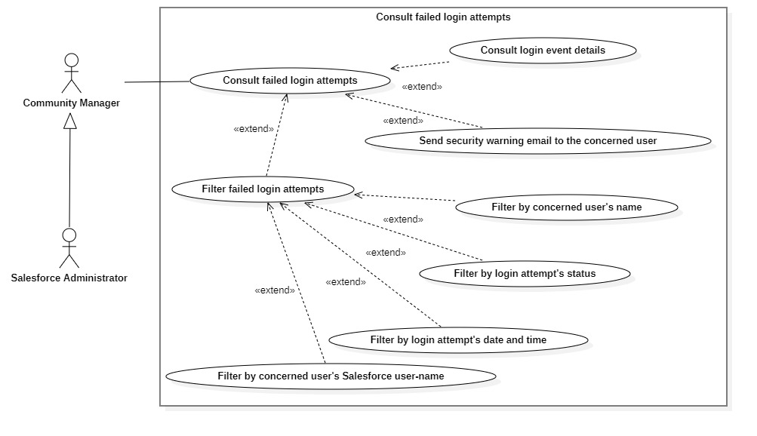
Consult failed login attempts UC
29

Slide 30
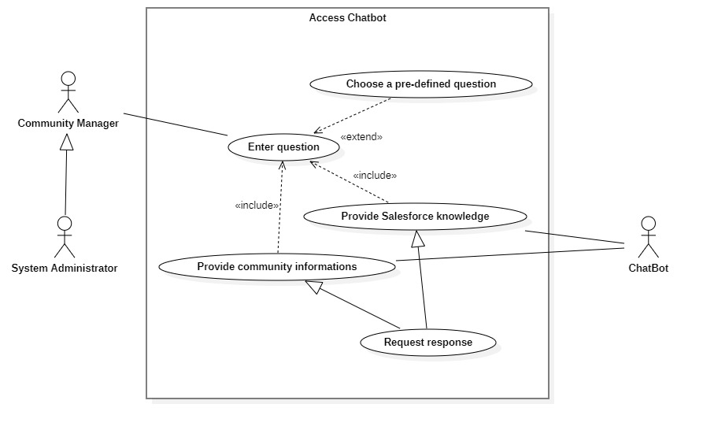
Access Chatbot UC
30

Slide 31
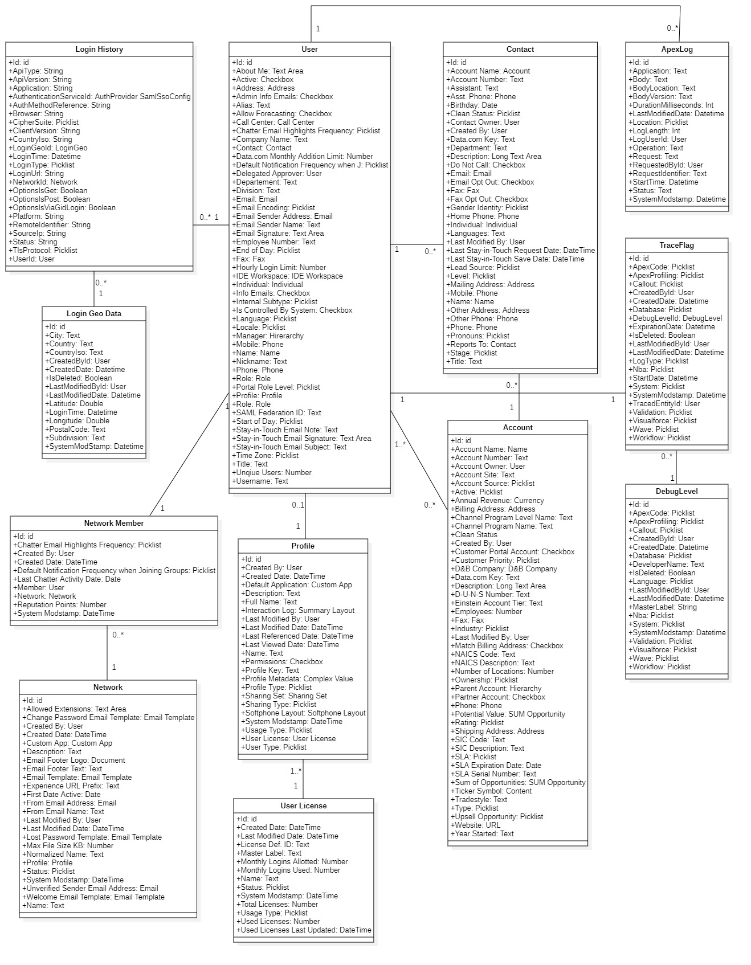
Class Diagram
31

Slide 32
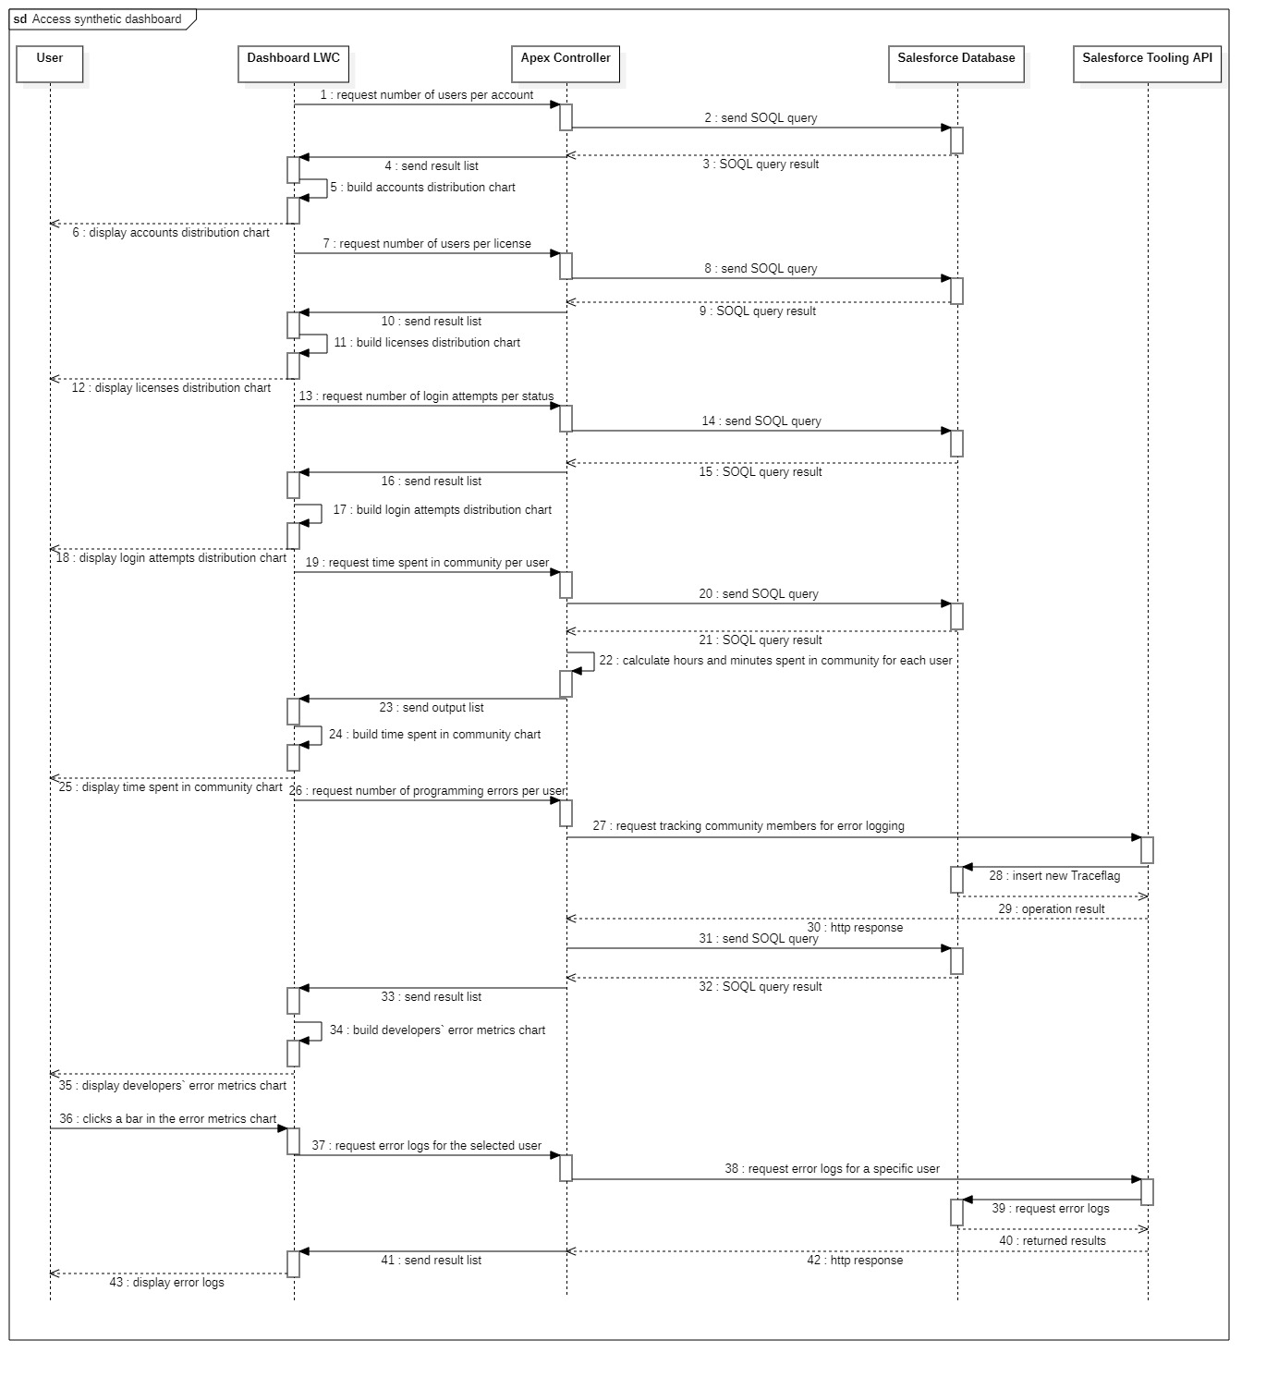
Access Dashboard Sequence Diagram
32

Slide 33
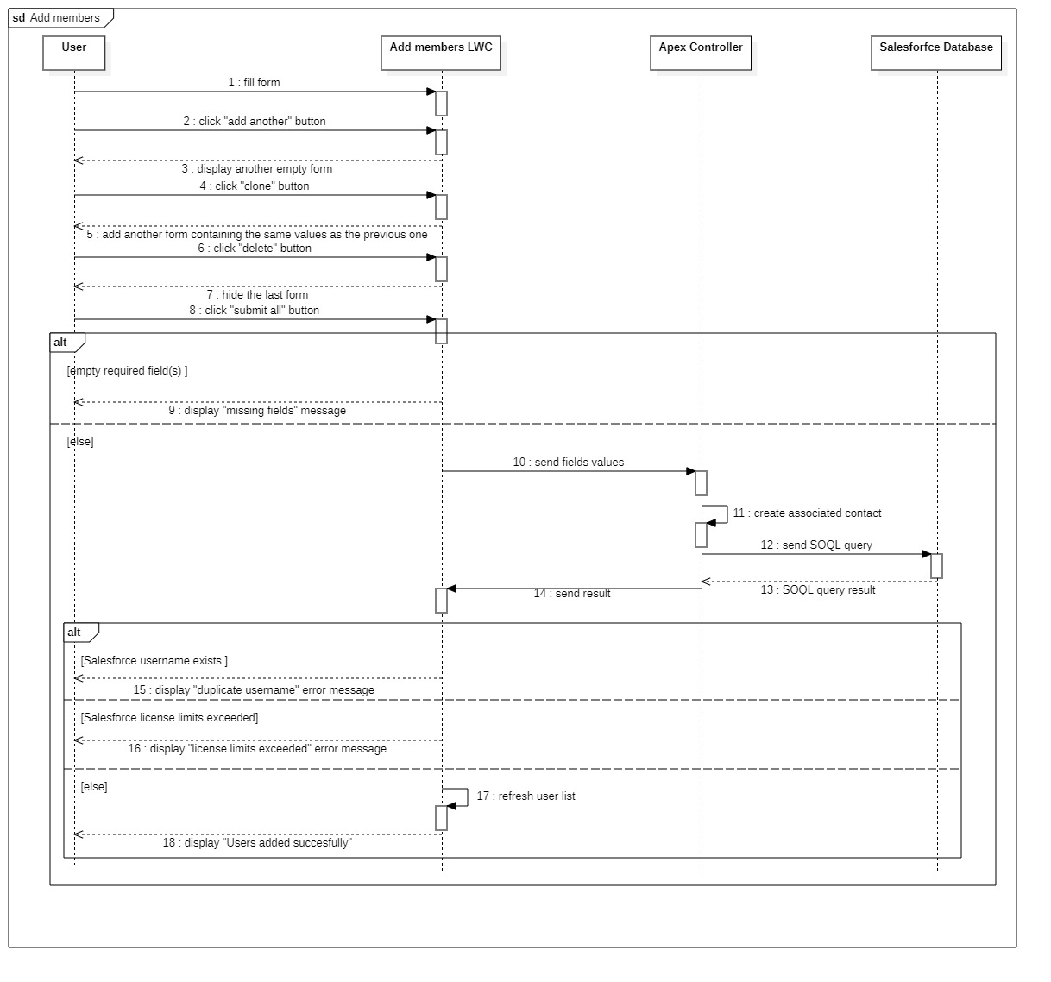
Add members Sequence Diagram
33

Slide 34
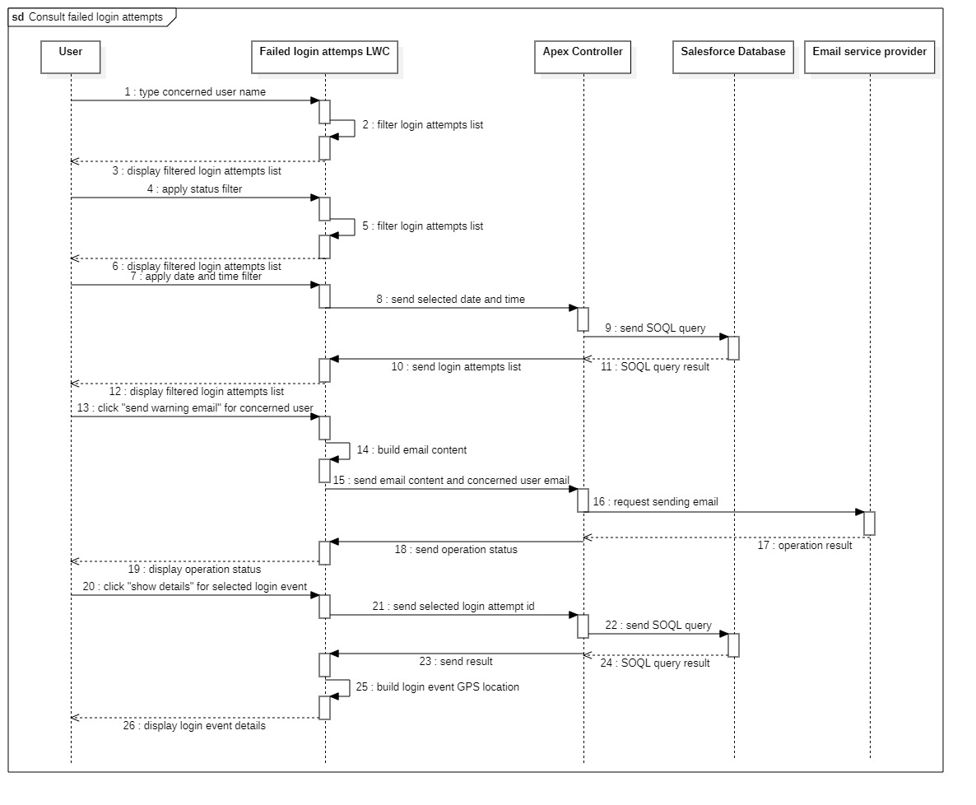
Consult failed login attempts Sequence Diagram
34

Slide 35
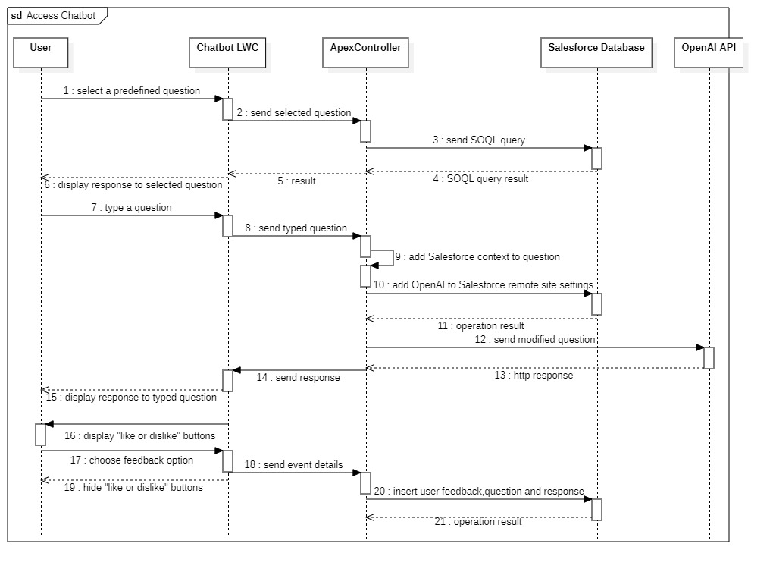
Access Chatbot Sequence Diagram
35

Slide 36
Implementation
06

Slide 37

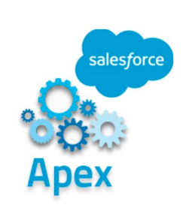
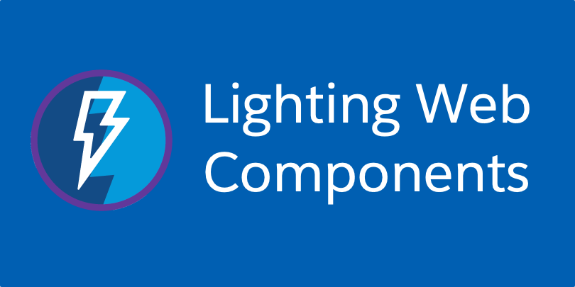
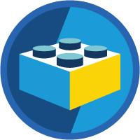


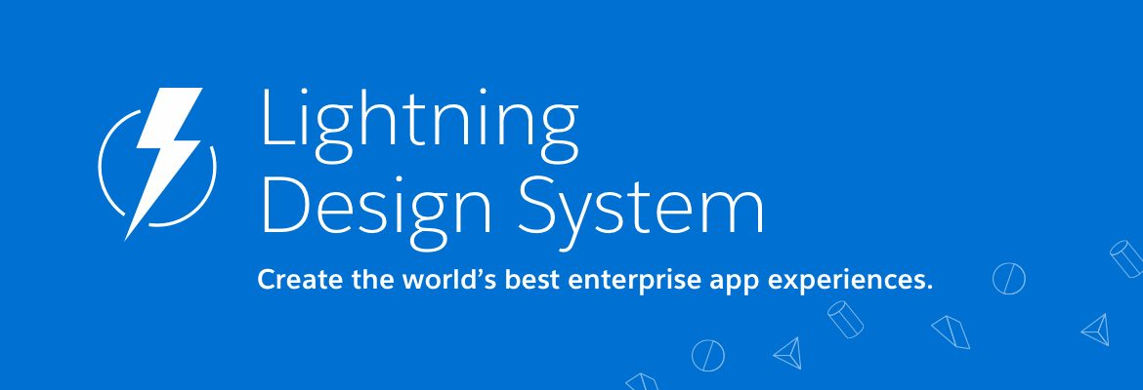




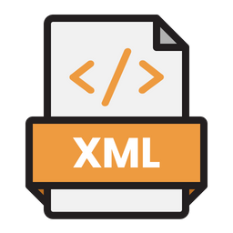

Software environment
Tools
Programming languages and frameworks
Aura
SOQL
37
Notes:
SLDS: Salesforce Lightning Design System
SOSL : Salesforce Object Search Language

Slide 38

Conclusion & Perspectives
The application carried out during our end of studies should facilitates the task of managing the members of Salesforce communities for community managers and administrators.
This project allowed us to improve our technical Salesforce knowledge given that we used a variety of technologies associated with said platform.
On the other hand, our realized application can be extended by : * further improving the Chatbot feature * adding an event notification system * adding multilingual support in future updates.
38
Notes:
You can mention that the app is deployed and accessible in the phone

Slide 39

THANK YOU

Slide 40
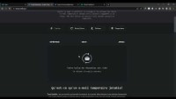
40

